Slide 1
Software Quality Assurance and Testing Technology
2nd Semester, Spring 2022
Xiaoping CHE (xpche@bjtu.edu.cn)
Associate Professor
School of Software Engineering
Beijing Jiaotong University

Slide 2
Rules
Project 20%
Assignments 40%
Final Exam 40%

Slide 3
How
16 Weeks Plan
Week 1: The basic concepts and theories of testing
Week 2-3: Principles of Testing
Week 4-5: Black Box Testing
Week 6-7: White Box Testing
Week 8: Unit Testing
Week 9: Integration Testing
Week 10-11: System Testing
Week 12: Regression Testing
Week 13-14: Software Testing Management
Week 15: International and Local Testing
Week 16: Future of Testing

Slide 4

How
References
Ron Patton, Software Testing (2th Edition)
Glenford J. Myers, The Art of Software Testing (3rd Edition)
Gerald M. Weinberg, Perfect Software

Slide 5
Review: Test thoroughness
Test code thoroughly, one of several approaches based on data manipulated by the code:
Statement testing: every statement is executed at least once in some test
Branch testing: every branch is executed at least once in some test
Path testing: every path is executed at least once in some test
Definition-use path testing
All uses testing
Statement, Path, Use

Slide 6
Review: Flow graph from code
.
.
.
Sequence
If-then-else
Case
Do-until
Do-while

Slide 7
Review: White-Box Testing
Statement Testing/Line Testing/Segment Testing
exercise each statement at least once
Basic Path Testing
exercise each independent path at least once
Condition Testing
exercise all logical conditions on their true and false sides
Decision Testing/Branch Testing
exercise each decision/branch at least once
Loop Testing
execute all loops at their boundaries and within their bounds
Data Flow Testing
exercise all data structures to ensure their validity

Slide 8
Review: Basis path test
A path through a program is a sequence of statements that starts at an entry, junction, or decision and ends at another (possible the same), junction, decision, or exit.
A path may go through several junctions, processes, or decisions, one or more times.
Paths consist of segments.
The smallest segment is a link. A link is a single process that lies between 2 nodes.
The length of a path is the number of links in a path.
An entry/exit path or a complete path is a path that starts at a routine’s entry and ends at the same routine’s exit.
1
2
3
4

Slide 9
Example
Procedure: process records
1. Do While records remain
2. Read record;
3. If record field 1 = 0 Then
4. store in buffer;
5. increment counter;
6. Else If record field 2 = 0 Then
7. reset counter;
8. Else store in file;
9. End If
10. End If
11. End Do
End

Slide 10
Review: Example
Procedure: process records
1. Do While records remain
2. Read record;
3. If record field 1 = 0 Then
4. store in buffer;
5. increment counter;
6. Else If record field 2 = 0 Then
7. reset counter;
8. Else store in file;
9. End If
10. End If
11. End Do
End
1
2
3
6
4
8
7
9
5
10
11
V(G) = 4

Slide 11
Basis path test example: FLOW GRAPH
1
2,3
6
4,5
8
7
9
10
11

Slide 12
Determine cyclomatic complexity of flow graph
Cyclomatic complexity: a quantitative measure of the logical complexity of code, provides an upper bound on the number of paths that need to be tested in the code
modules
Higher Cycloramic Complexity, more possibility in error
V(G)
modules in this range are more error prone
V(G) =number of regions (areas bounded by nodes and edges—area outside the graph is also a region)
V(G) = number of edges - the number of nodes + 2
V(G) = number of (simple) predicate nodes + 1
Notes:
2. Determine the cyclomatic complexity of the resultant flow graph
Note: can be determined without developing a flow graph
count all conditional statements in a component
→ compound conditions count as 2
(number of Boolean operators + 2)

Slide 13
Basis path test example : FLOW GRAPH
1
Region 1
Region 4
2,3
6
4,5
Region 2
7
Region 3
8
9
10
V(G)=4
11

Slide 14
Review: Basis path test
Complete paths are useful for testing because:
It is difficult to set up and execute paths that start at an arbitrary statement.
It is difficult to stop at an arbitrary statement without changing the code being tested.
We think of routines as input/output paths.
Path Selection Criteria
There are many paths between the entry and exit points of a typical routine.
Even a small routine can have a large number of paths.

Slide 15
Review: Determine a basis set of linearly independent paths
Independent path ® any path that introduces at least one new set of processing statements or a new condition
Basis set ® set of independent paths through the code
Test cases derived from a basis set are guaranteed to execute every statement at least one time during testing
Basis set is not unique
Notes:
3. Determine a basis set of linearly independent paths
equal to cyclomatic complexity number
identify predicate nodes as an aid in derivation of test cases

Slide 16
Review: Basis path test example
Path1: 1-2-3-6-7-9-10-1-11
Path2: 1-2-3-6-8-9-10-1-11
1
Path3: 1-2-3-4-5-10-1-11
2
Path4: 1-11
3
6
4
7
8
9
5
11
10

Slide 17
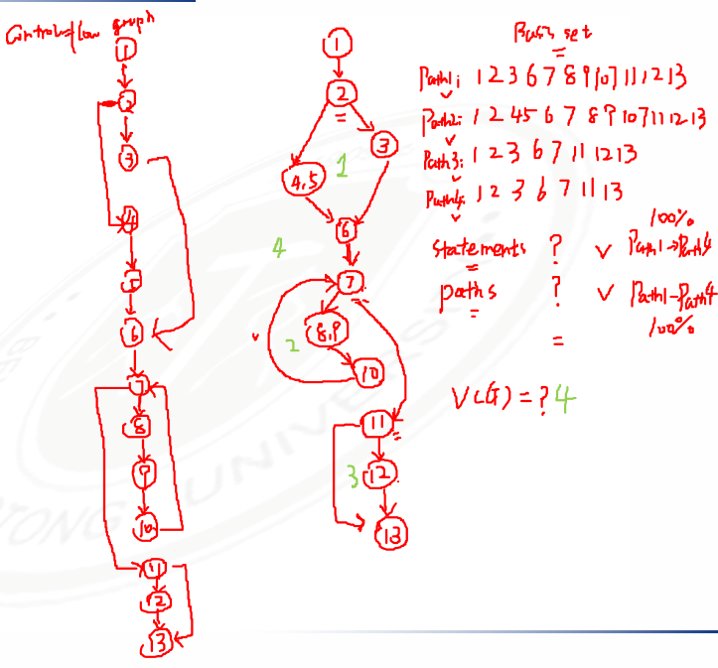
Review: Basis path test example
1 scanf(“%d %d”,&x, &y);
2 if (y < 0)
3 pow = -y;
4 else
5 pow = y;
6 z = 1.0;
7 while (pow != 0) {
8 z = z * x;
9 pow = pow - 1;
10 }
11 if (y < 0)
12 z = 1.0 / z;
13 printf (“%f”,z);

Slide 18
Basis path test example
for (j=1; j<N; j++)
{
3 last = N - j + 1;
4 for (k=1; k<last; k++)
5 {
6 if (list[k] > list[k+1])
7 {
8 temp = list[k];
9 list[k] = list[k+1];
10 list[k+1] = temp;
11 }
12 }
13 }
14 print(“Done\n”);

Slide 19
To be continued… See you next week

